Slide 1

Rainfall Prediction Using Clouds Images
Cloud mapping and classification involve identifying, categorizing, and analyzing cloud formations. Understanding cloud patterns is essential for various applications, from weather forecasting to climate research.
Presented by Srikar

Slide 2

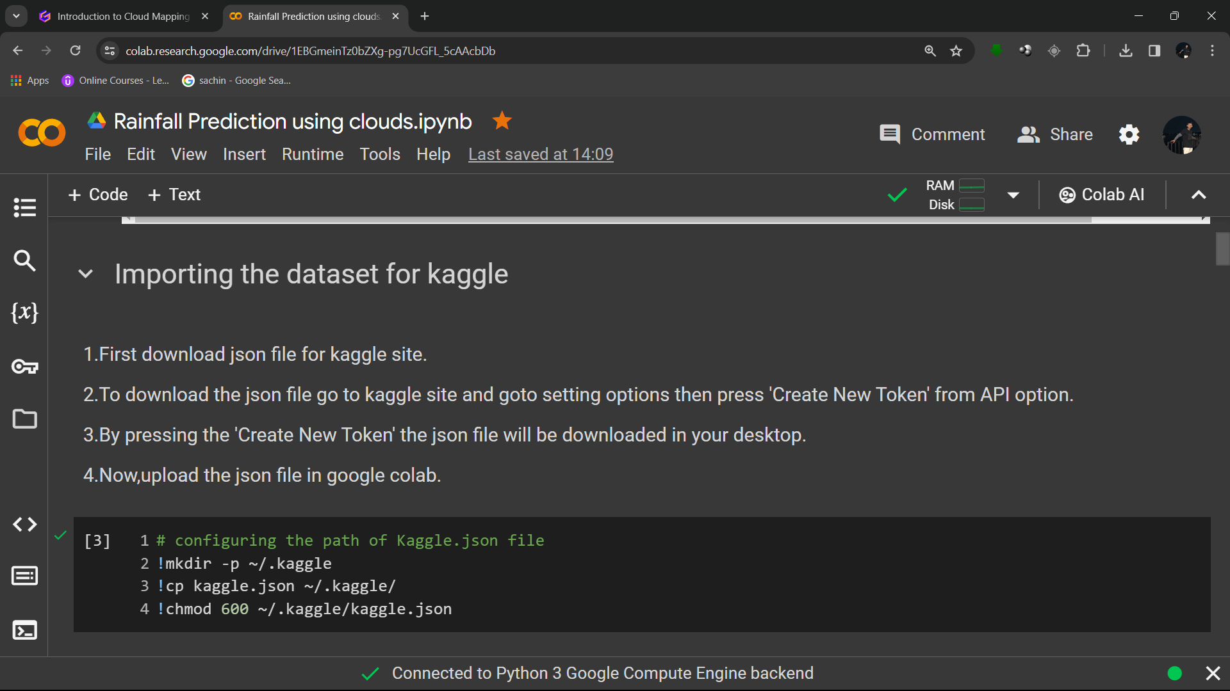
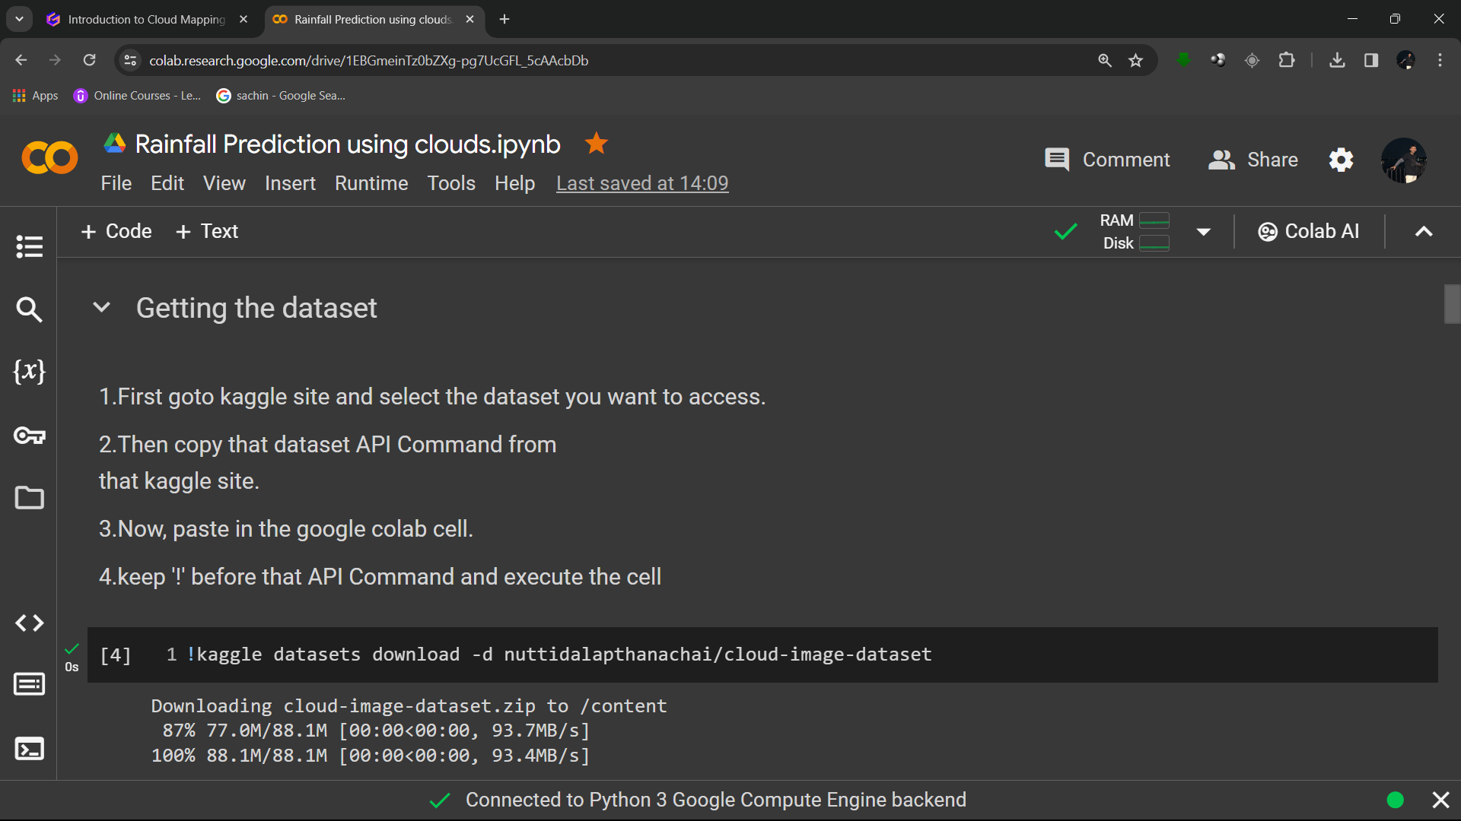

Data Collection
1.Accessing the dataset from the Kaggle website.
2.First, download the json file from Kaggle website.
3. Then upload the json file in the google colabaratory as show in the below.

Slide 3
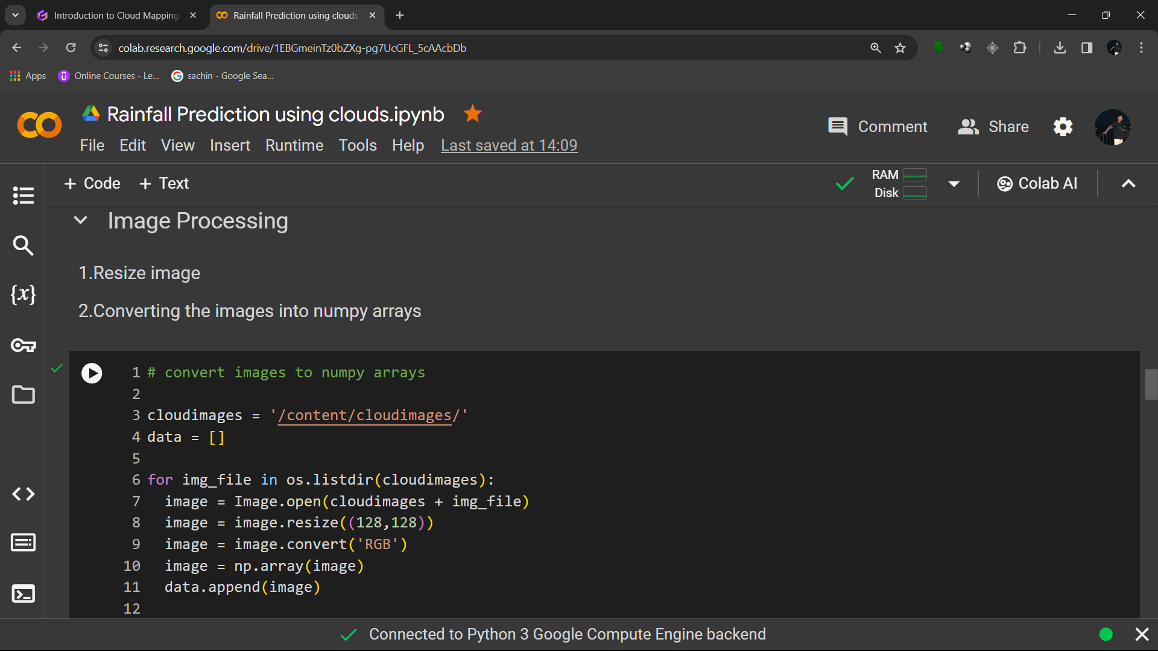
Data Preprocessing
Preprocess the images as necessary, which may include resizing, normalization, and augmentation to increase the diversity of the dataset.

Slide 4
Training and Testing the Machine Learning Model
Data Splitting
1
Divide the cloud dataset into training and testing sets.
2
Model Evaluation
Assess the model's performance and accuracy in classifying cloud shapes.
Iterative Improvement
3
Refine the model based on testing results and real observations.

Slide 5
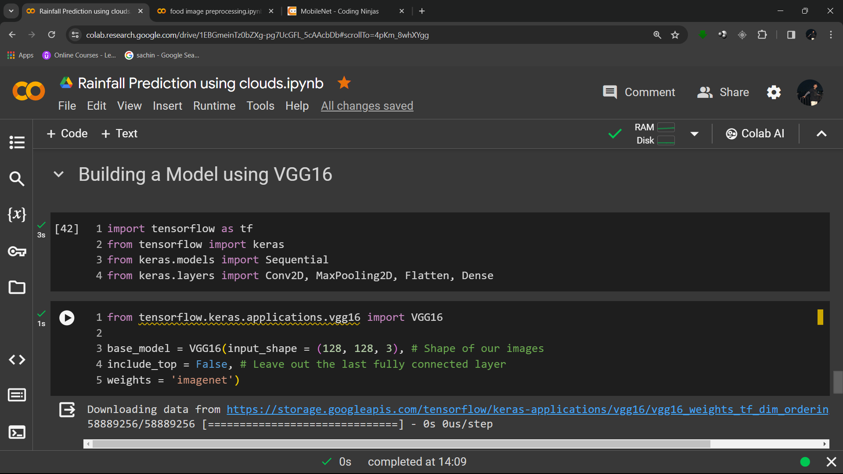
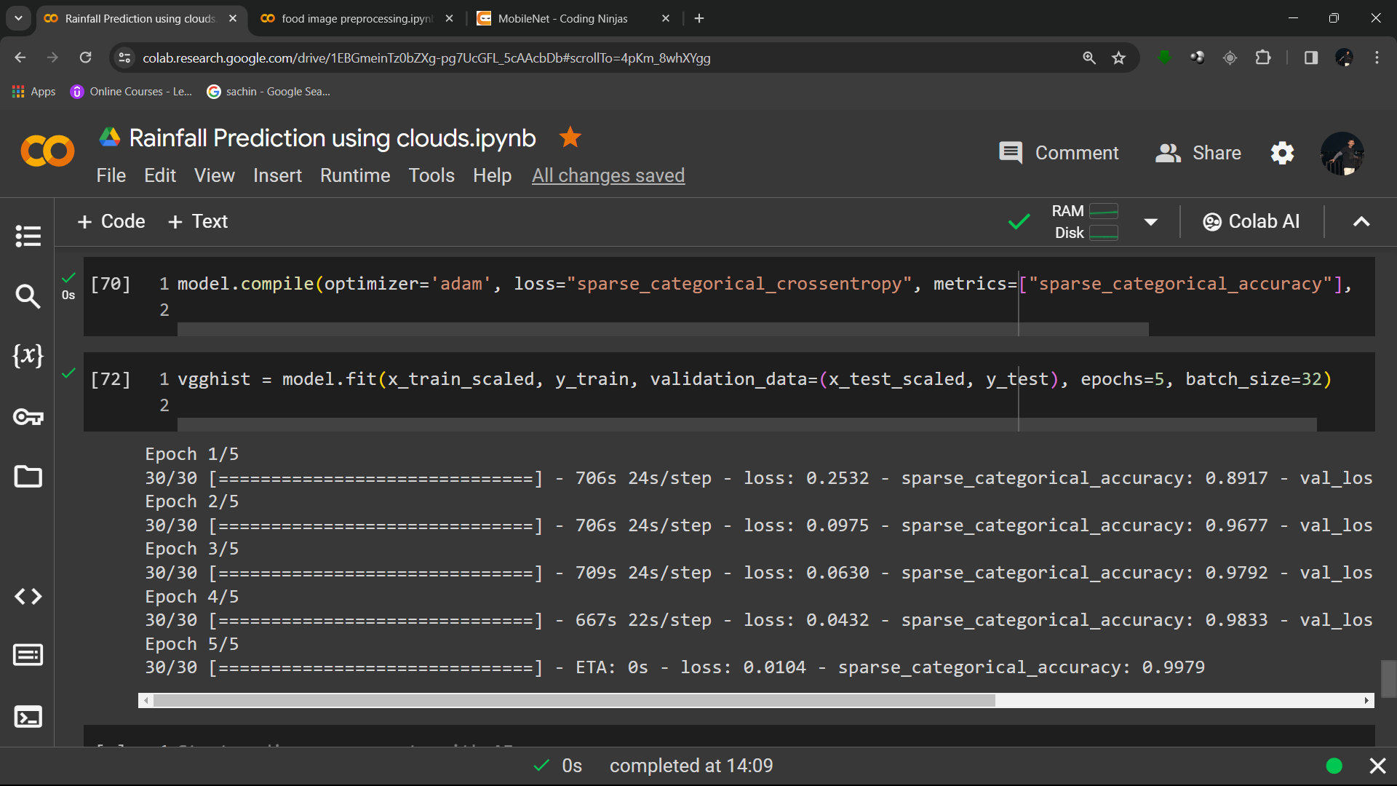
Model Selection and Training
Choose a suitable machine learning model for image classification, such as VGG16. Train the model on the dataset to learn to classify cloud shapes and predict weather conditions.

Slide 6

Model Evaluation
Evaluate the trained model on a separate validation dataset to assess its performance. You may need to fine-tune the model or adjust hyperparameters to improve performance.
Accuracy Score :Measures the proportion of correctly classified instances out of all instances. It is a good general evaluation metric but may not be suitable for imbalanced datasets.
Recall Score:Measures the ability of the model to correctly identify instances of a class. It is also known as sensitivity or true positive rate.
Confusion Matrix:A table showing the number of correct and incorrect predictions, organized by true and predicted class labels.
F1 Score:Harmonic mean of precision and recall. It balances both precision and recall and is particularly useful when classes are imbalanced.

Slide 7
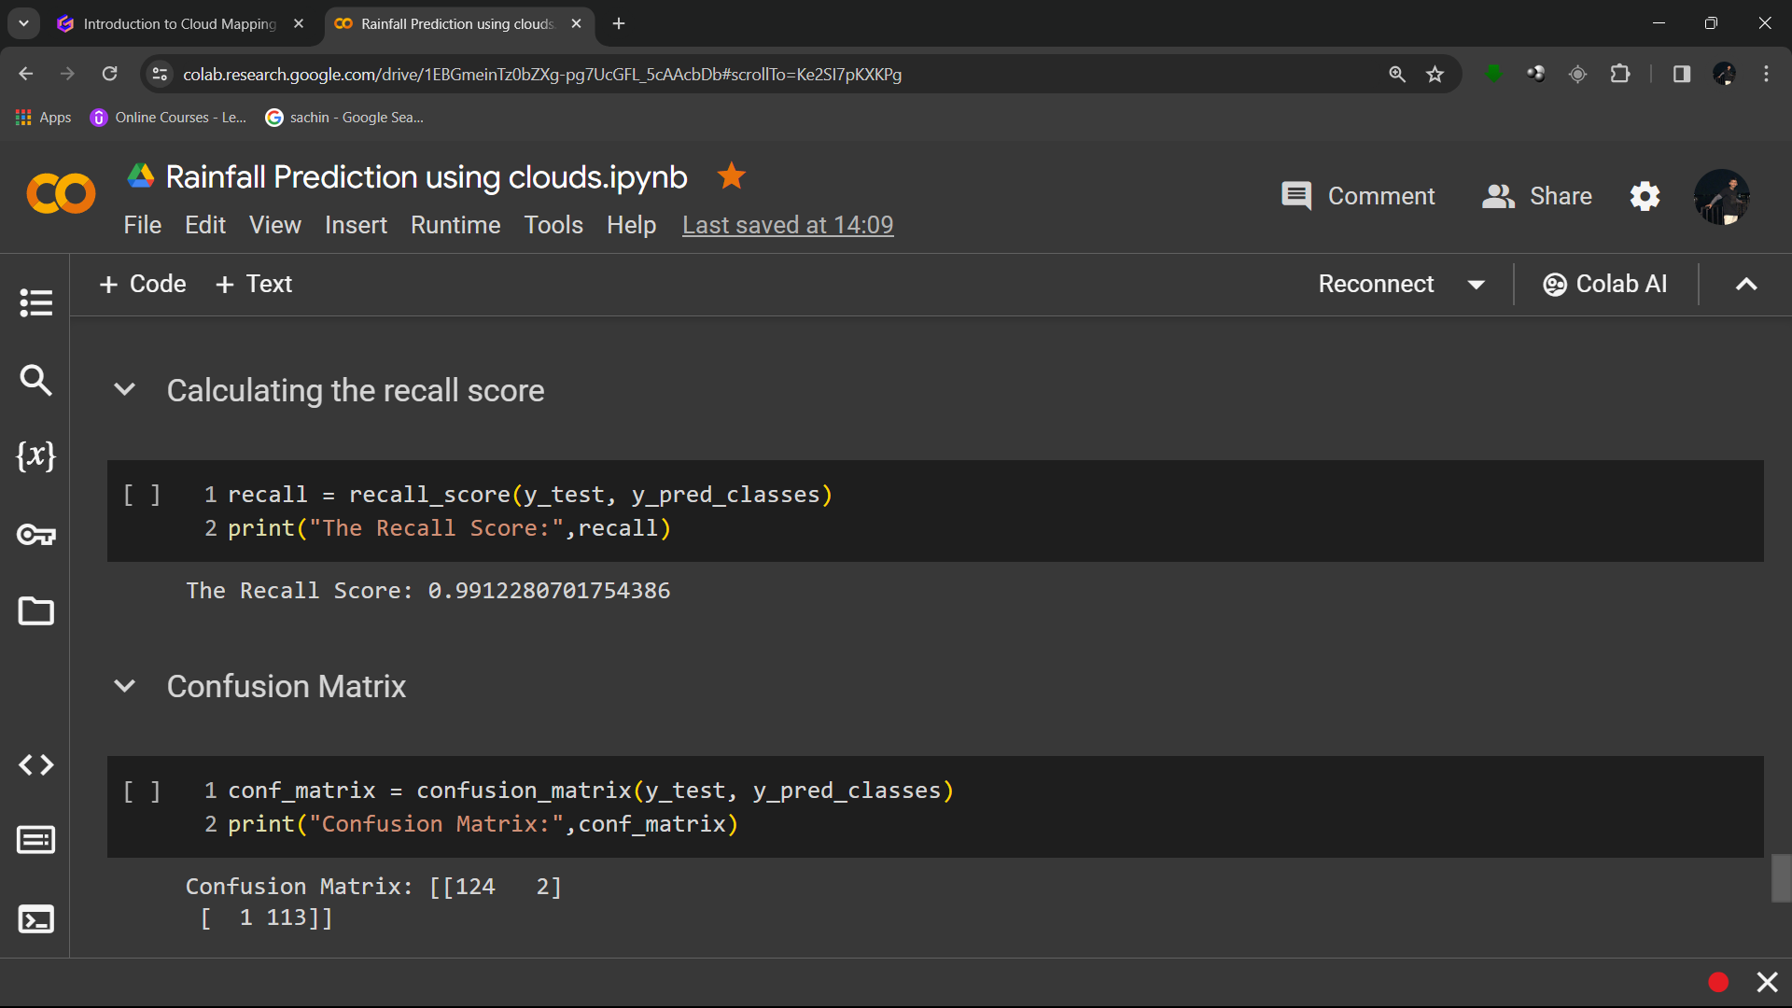
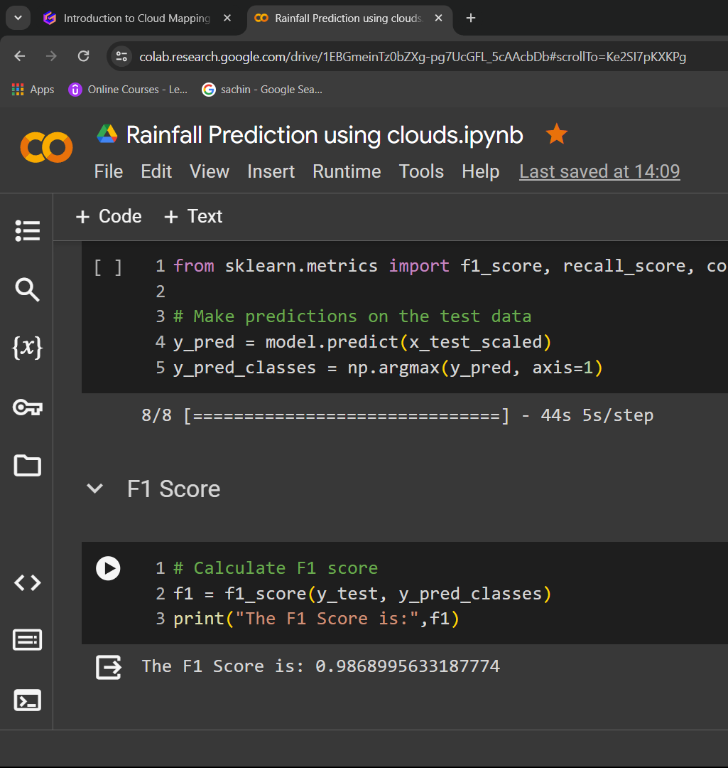
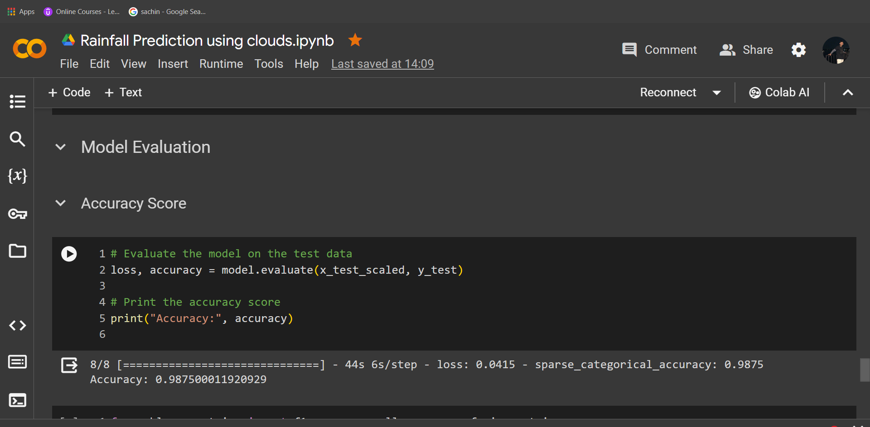

Slide 8
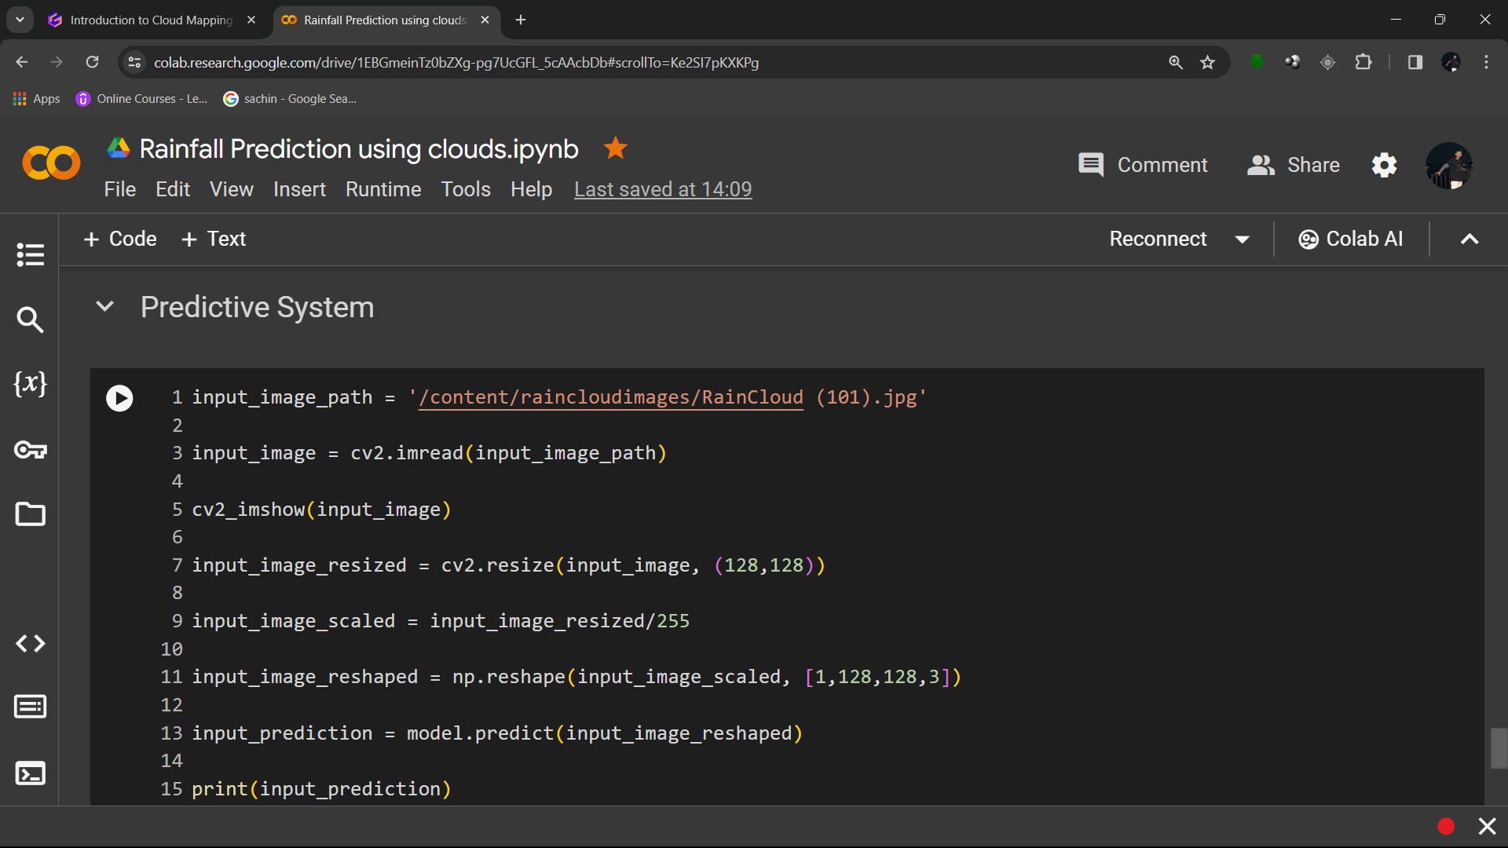
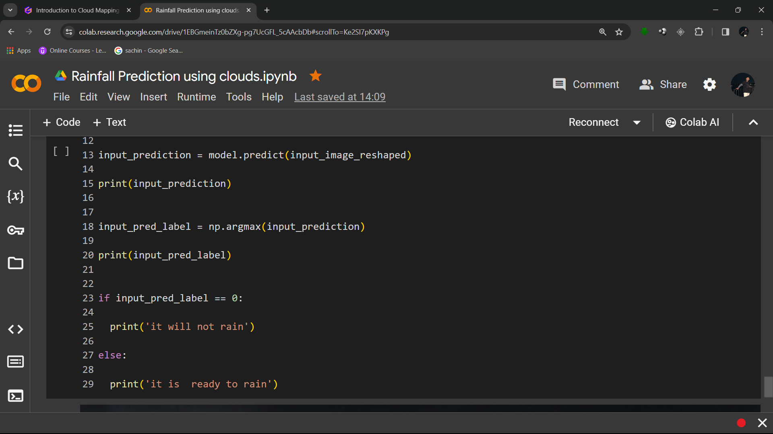
Integration with Rainfall Prediction
Once you have a trained model for cloud shape classification, integrate it with a rainfall prediction model. This could involve using the cloud shape classification results as features in a rainfall prediction algorithm.

Slide 9
Thank you

